Slide 1



ELISKA, FABIAN, MJ & TUNG
IRONHACK DATA ANALYTICS WEEK 3
A TALE OF THREE CITIES
A TALE OF THREE CITIES
A case study analysis of housing trends in Europe post-pandemic (2019-2023)

Slide 2
Is the dream of homeownership in Europe's capitals dying?
We feel it everyday: things are getting more and more expensive. But how much so? Is it still reasonable to expect to own a home one day? Will Gen Z be renting for their entire lives?
1. Has income kept up with this rise in cost?
2. Have mortgages kept up with rising rents, or is one noticeably less affected by inflation?
3. Do realities in our capital cities follow national averages, or is inflation more extreme in urban areas?
Project Overview
Notes:
Fabian
Analyze and visualize the trends in income (average and minimum wage) and housing costs across key European cities to understand affordability for potential homeowners and renters.

Slide 3
The team found 3 primary sources and sculpted 3 data sets for the hypotheses.
Using these 3 data sets, the team then conceptualized a set of visuals
Sources - Eurostat, Statista, Numbeo
Project
Data
Notes:
Fabian

Slide 4

Data Wrangling and Cleaning
Apart from the standard missing values, white spaces, formatting issues....
Worked with quite clean data, but several tabs, and using the concatenate function
Using functions to calculate the percentage of income
Worked with new values from the cleaned datasets : minimum wage, average buying price from different tables
Notes:
Hand over to Eliska

Slide 5

Exploratory Data Analysis
Inferential and summary statistics, visualization (Matlib and Plotly) and relationships between variables
Trend & Case study analysis
Notes:
Share insights and interesting patterns you found.

Slide 6






Case studies
Berlin, DE
Lisbon, PT
Paris, FR
Berlin’s economy has grown rapidly, driven by tech expansion and foreign investment, but rising rents and living costs have strained affordability.
Lisbon has significant economic expansion, boosted by tourism, tech and foreign investment . Rising property prices and a high COL relative to local wages increase financial pressure
Paris’s economic growth has remained steady but faces ongoing challenges with high living costs, shortages in hosing and affordability in general
Notes:
MJ

Slide 7
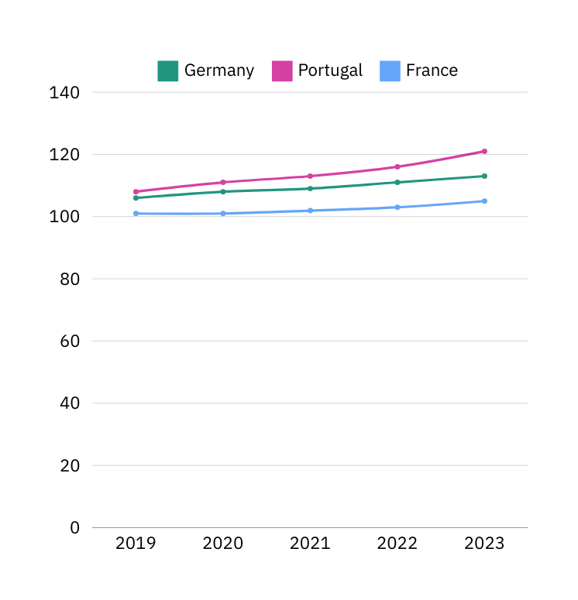
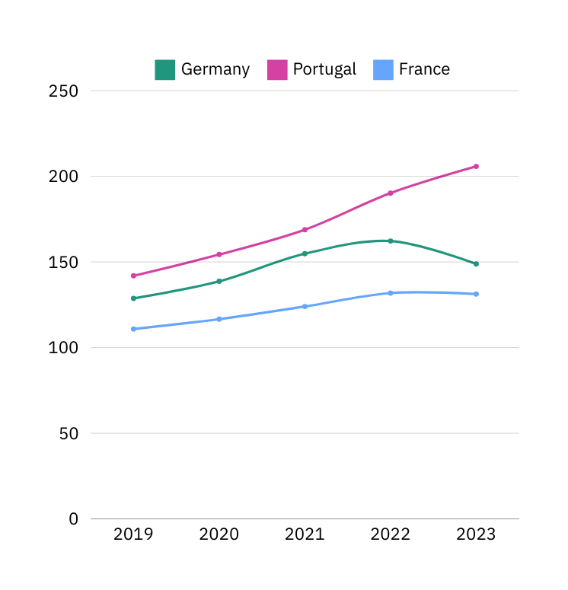
Rental & Housing Trends
Rental Price Index over time
House Price Index over time
Notes:
MJ

Slide 8
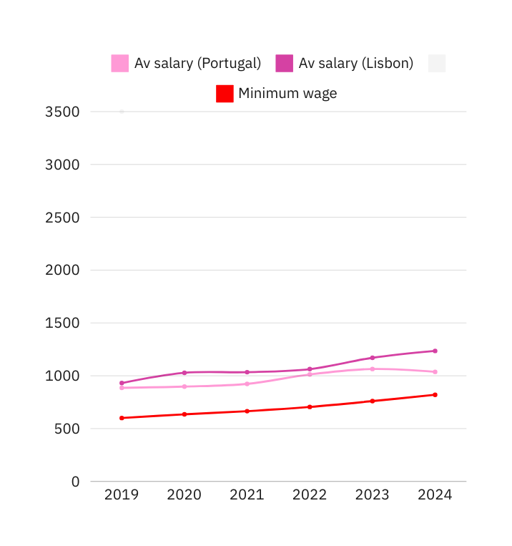
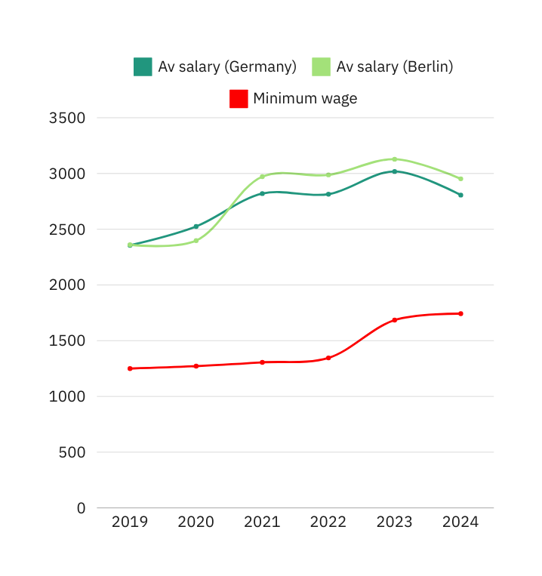
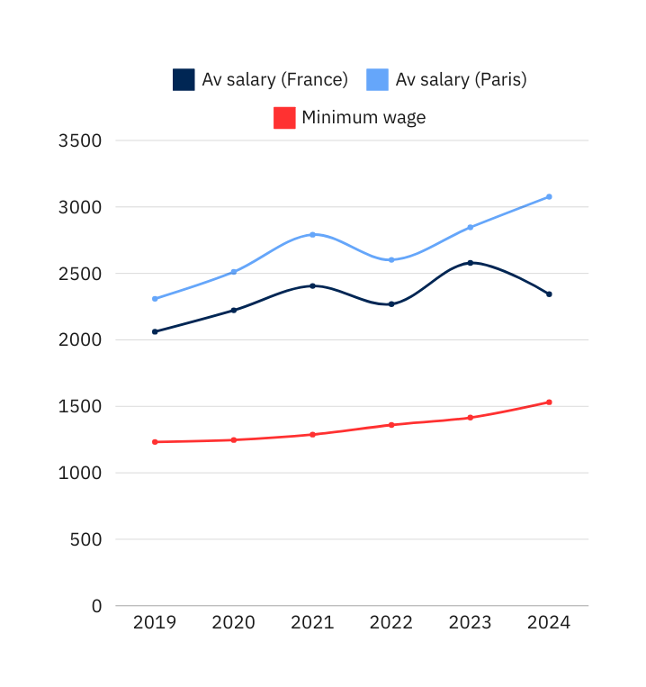
How do salaries in cities compare with their country averages?
Lisbon
Berlin
Paris
Notes:
MJ
Berlin's average salary increased past the national average in mid 2020
Paris had a dip in its average salary after the COVID crisis.
The French national average salary dipped down after 2023 for unknown reasons
Berlin's minimum wage increased from 2022 to 2024 by 400€ - this did not affect the average

Slide 9
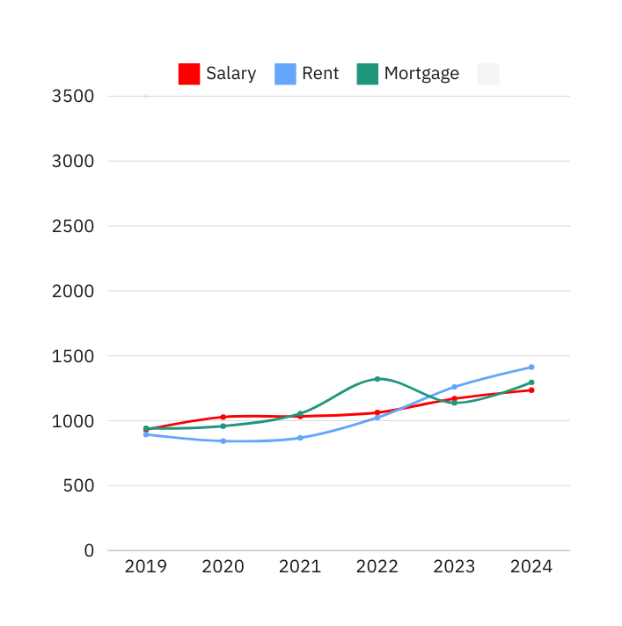
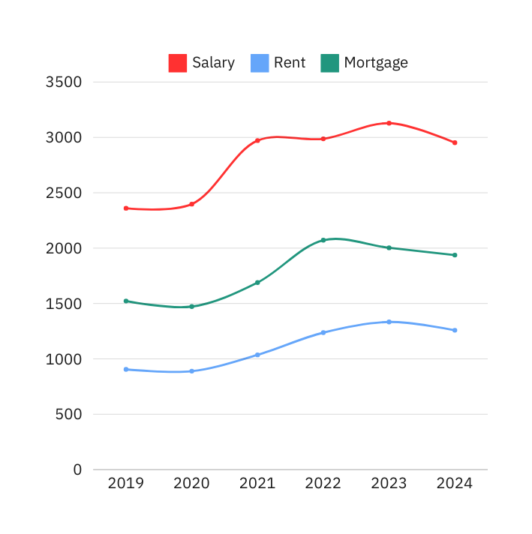
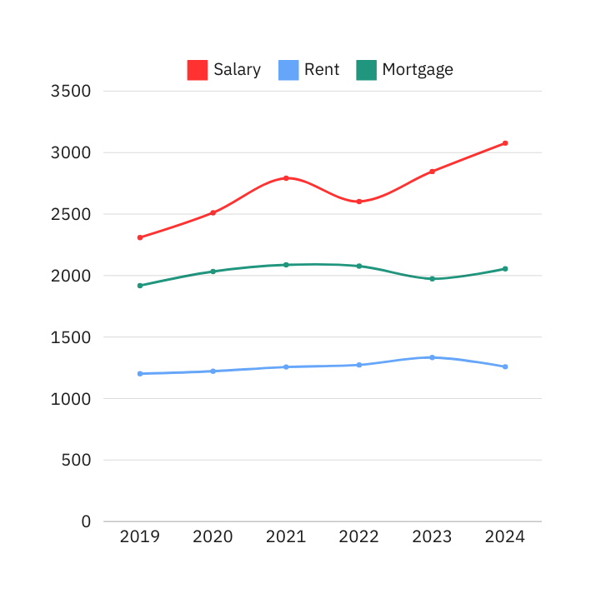
Average salary vs rent and mortgage (per month) per city
Lisbon
Berlin
Paris
Notes:
MJ
Lisbon has rent, mortgage line graphs cross the average salary
Mega-insight(presented in last slide) - In Lisbon its more value oriented to have a mortgage then rent an apartment.

Slide 10





Can I afford to buy in Berlin?
Average Berlin salary per month: €2952
The average Berliner needs 40% of their salary to rent a one bedroom flat-- that's already 10% over what's recommended
A mortgage on a similarly-sized flat would cost 65% of their monthly salary
Notes:
Tung

Slide 11



Can I afford to buy in Paris?
Average Paris salary per month: €3077
The average Parisian needs 41% of their salary to rent a one bedroom flat-- that's 11% over what's recommended
A mortgage on a similarly-sized flat would cost 67% of their monthly salary
Notes:
Tung

Slide 12





Can I even afford to exist in Lisbon?
Average Lisbon salary per month: €1235
The rent on a one bedroom apartment is 114% of the average salary
Mortgages are 10% cheaper than rent -- 104% of the average salary
Notes:
Tung

Slide 13
Key Insights on Data
One
Two
Three
Four
In all cities, the price of rent and owning is higher than the recommended 30% threshold
Unlike in Paris and Berlin, getting a mortgage is more value-oriented than renting in Lisbon -- if you can afford it
Gen Z has very low prospects for owning a home on an average salary
In Lisbon and Portugal minimum wage is closer to salary averages, this indicates even though salaries are lower, the range of inequality is smaller
Notes:
Go in alphabetical order
Eliska
Fabian
MJ
Tung

Slide 14
keep it
The schedule we made was respected par VCS problems
Our team fused very well as the differing expertise was seen in most aspects of the project
From start our team had a focus on risk management and there was a push to come out with an minimally viable project
We learned to solve problems together according to our different skillsets
Important to be on the same page about our hypothesis and research questions and check in often
SIMPLE
Teamwork and
Project management
Notes:
Tung

Slide 15

"GitHub pull requests: because who needs
sleep when I have merge conflicts to fight?"
Obstacles
Finding and refining the right hypothesis
Using, debugging and uncorrupting Github
Working together on virtual environments
Notes:
Tung

Slide 16

Thank you!
ELISKA, FABIAN, MJ & TUNG
IRONHACK DATA ANALYTICS WEEK 3
Merci! Danke! Ďakujem vám! Obrigada!

